Slide 1
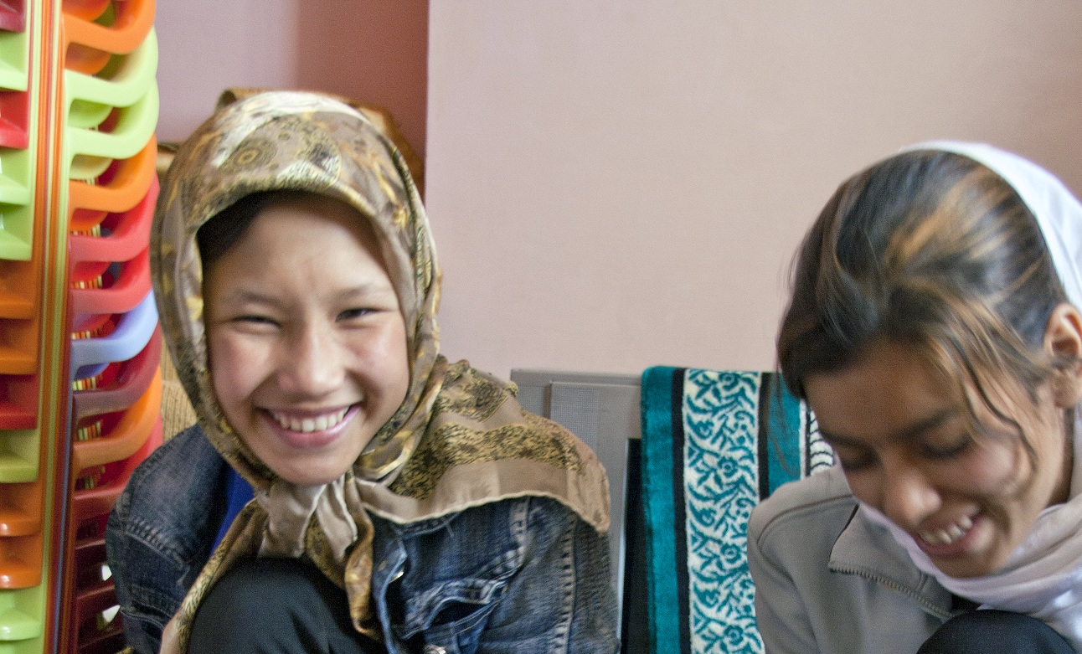







PHOTO Palwesha Yusaf
A Night at the Sydney Opera House
Stronger Futures for Women and Girls in Afghanistan
Join us to support the work of UN women in improving the lives of women and girls in Afghanistan. Enjoy wine and canapes served by ARIA Catering, against the glorious backdrop of the harbour at this truly iconic venue, The Sydney Opera House. All proceeds from ticket sales will go directly to UN Women Afghanistan.
Sydney Opera House – Northern Foyer
Friday 28 June 2012 – 7:30pm
Tickets $85 ($50 for student)
Guest Speakers
Karen Middleton
One line
Waleed Aly
One line
Penny Williams
One line
Ben Quilty
One line
www.unwomen.org.au

